Slide 1
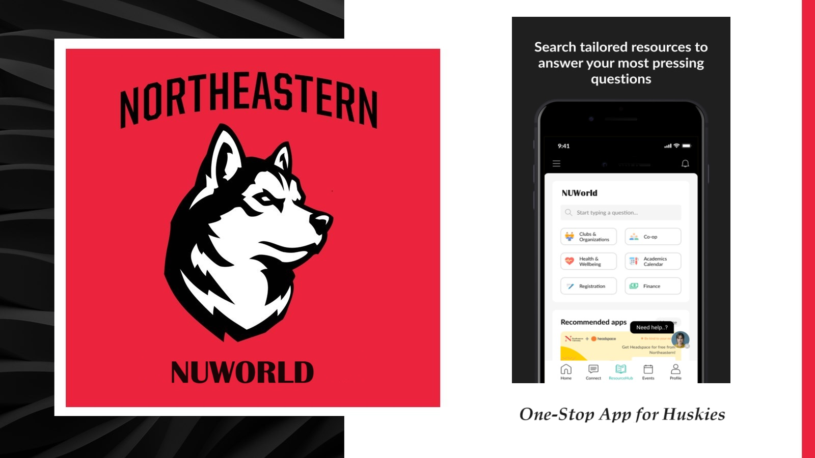
Pujitha Sai Tulasi Muddhu
April 7th, 2024
EMGT 5220
Instructor: Prof. George Kontopidis

Slide 2
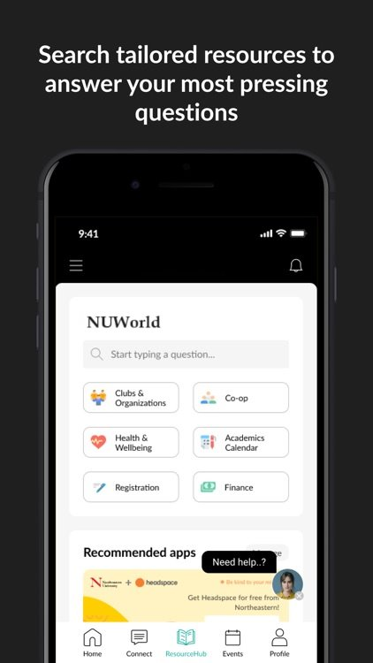

Objective
Our Team will develop NUWorld - a user-friendly mobile application to address challenges faced by huskies regarding
Timely Accessibility
Accurate Information
Fragmented Communication

Slide 3
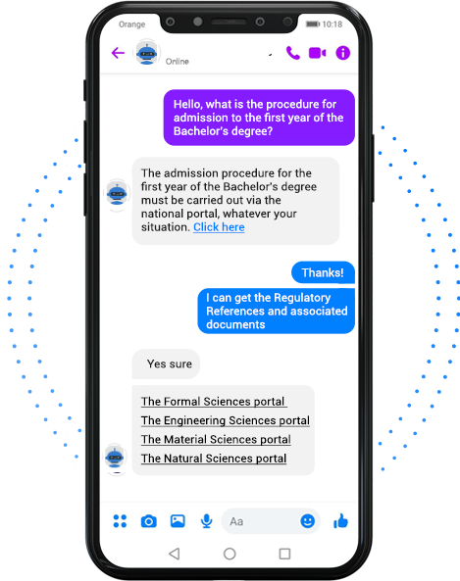
Scope 1. Chat Bot Capability 2. Real Time Updates 3. Personalization Features

Slide 4
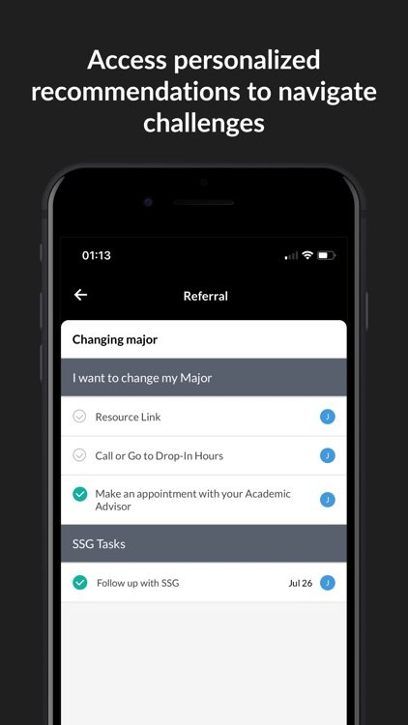
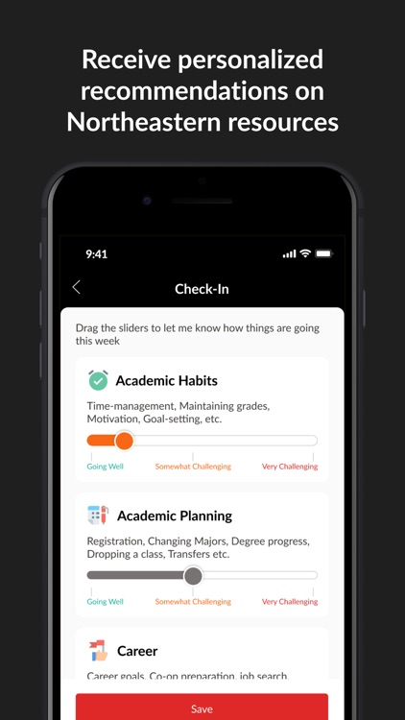
Real-Time Updates and Personalized Features
Comprehensive Info on On-Campus services (library hours, IT support, health services, dining options)
Academic Schedules (Course Timetable, Lecture Details, Exam Dates)
Set Preferences
Receive Reminders for upcoming classes
Bookmark events
Receive Notifications

Slide 5
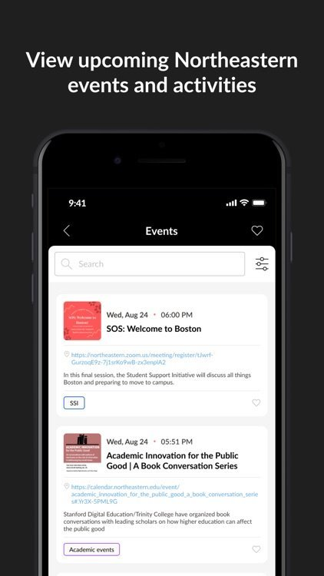
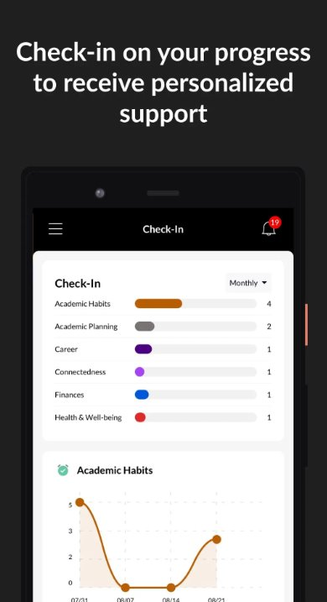
Dynamic event calendar for diverse university events (lectures, workshops, social gatherings, extra-curricular activities)
Progress Check-in

Slide 6
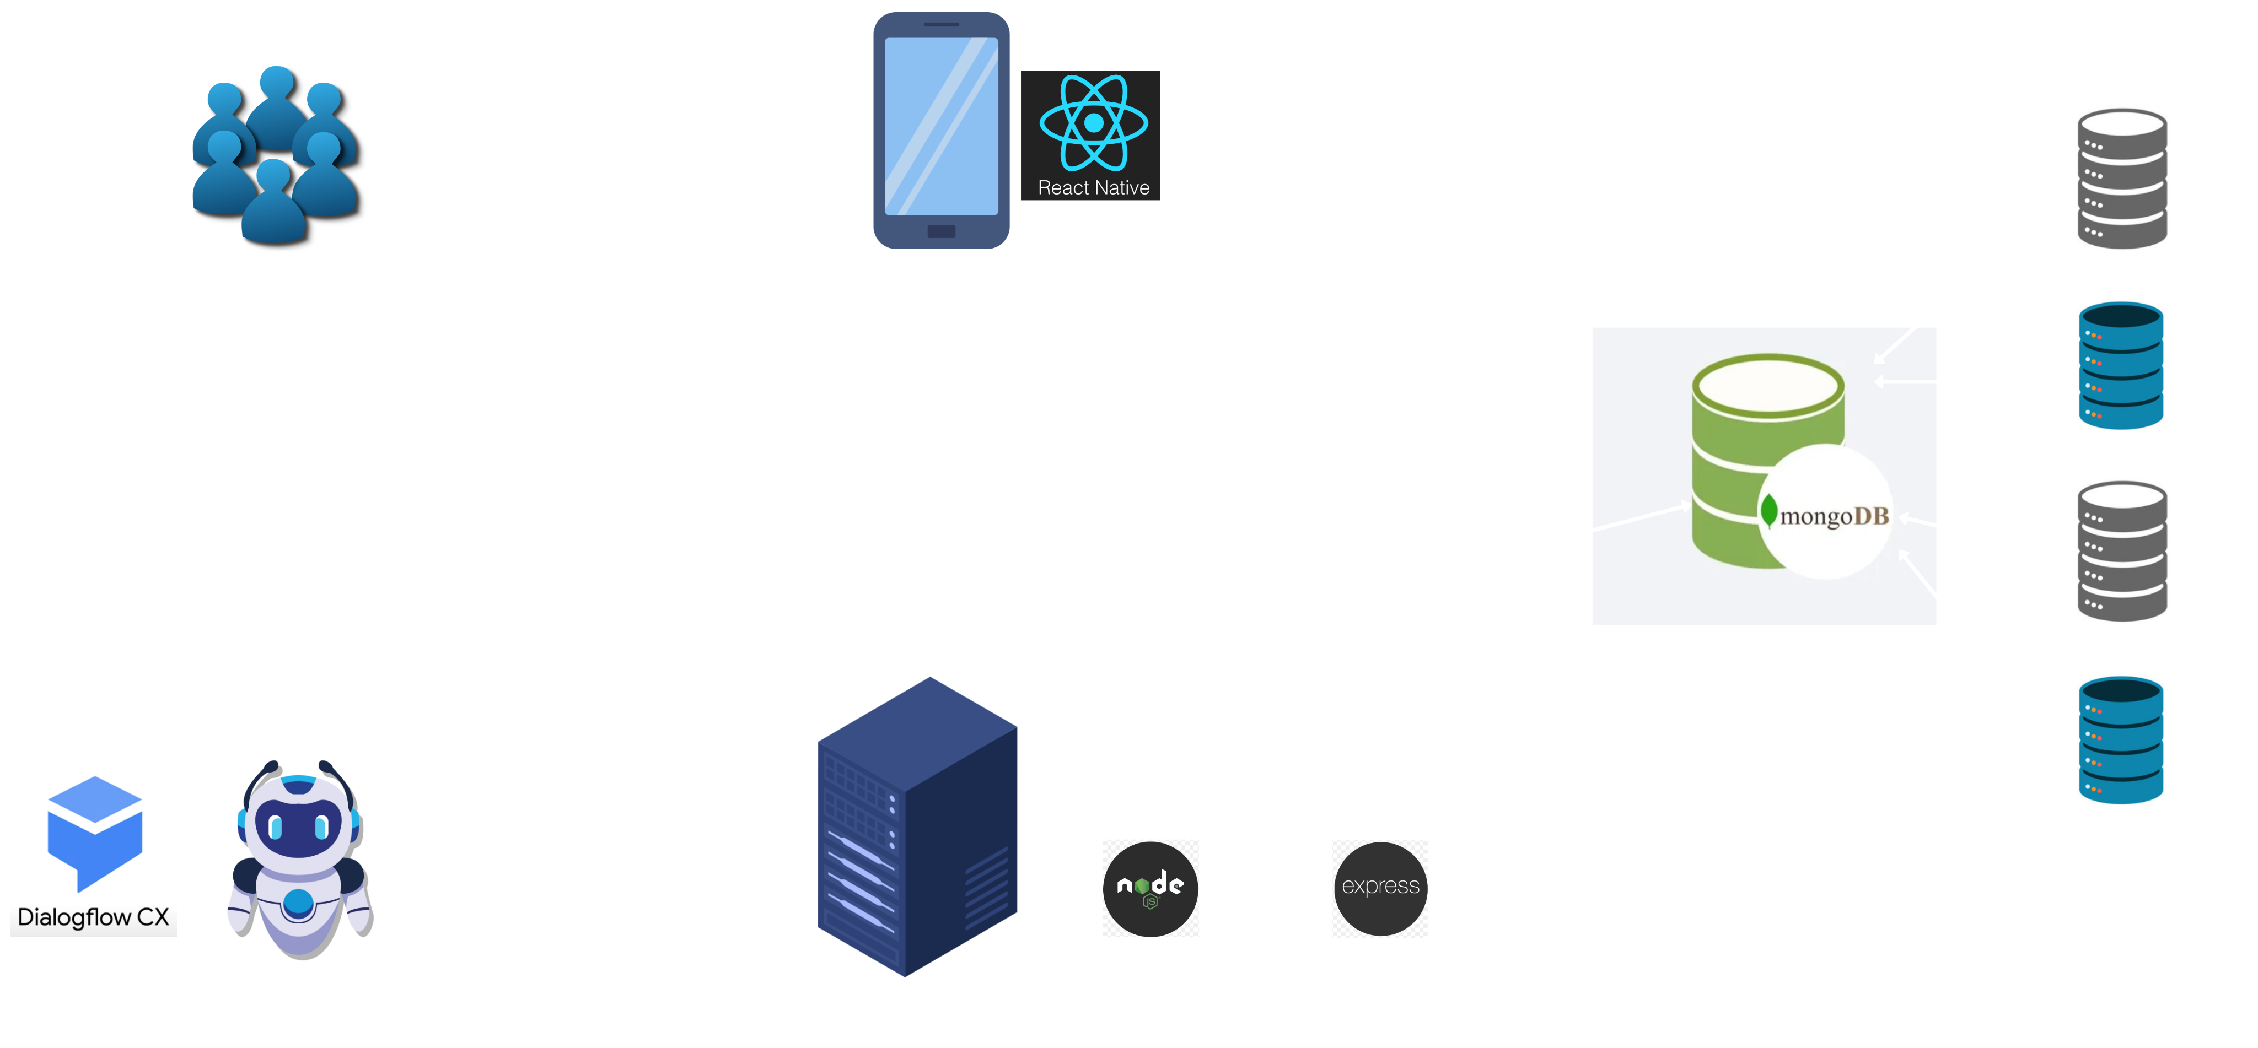
Milestone 1: FE Development for User Friendly Interface and Personalization
Milestone 2: BE Development for Real Time Information Updates
Milestone 3: Chat Bot Integration

Slide 7
Thank You

